Slide 1




Research Symposium
May 5-July 24, 2020
Maitreyi Joshi
24/07/2020

Slide 2
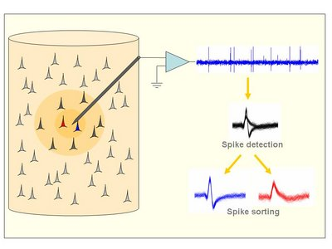
Introduction-Spike Sorting
Extracellular recording of action potential of neurons from large MEA’s- often necessitates - spike sorting.
Spike sorting refers to mapping the spiking activity(action potentials) of individual neurons extracted from the raw voltage traces.

Slide 3
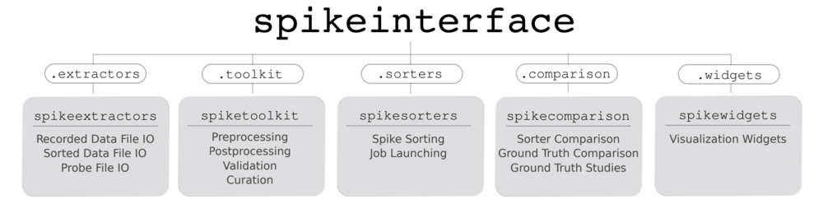
Spike sorting Benchmarking
Spike Forest and Spike Interface tools are used to benchmark various spike sorting algorithms like Mountain Sort ,Kilo Sort and SpykingCircus.
These tools provide an easy interface to pre process, run the sorters (through wrappers) and validate the results with ground truth.

Slide 4
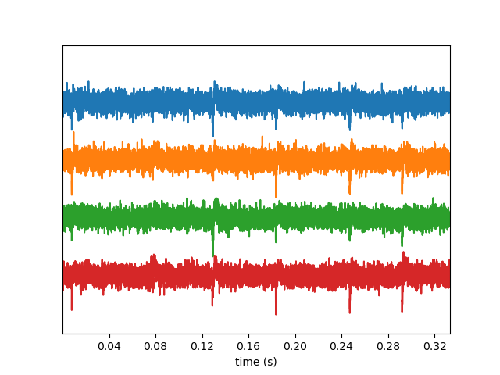
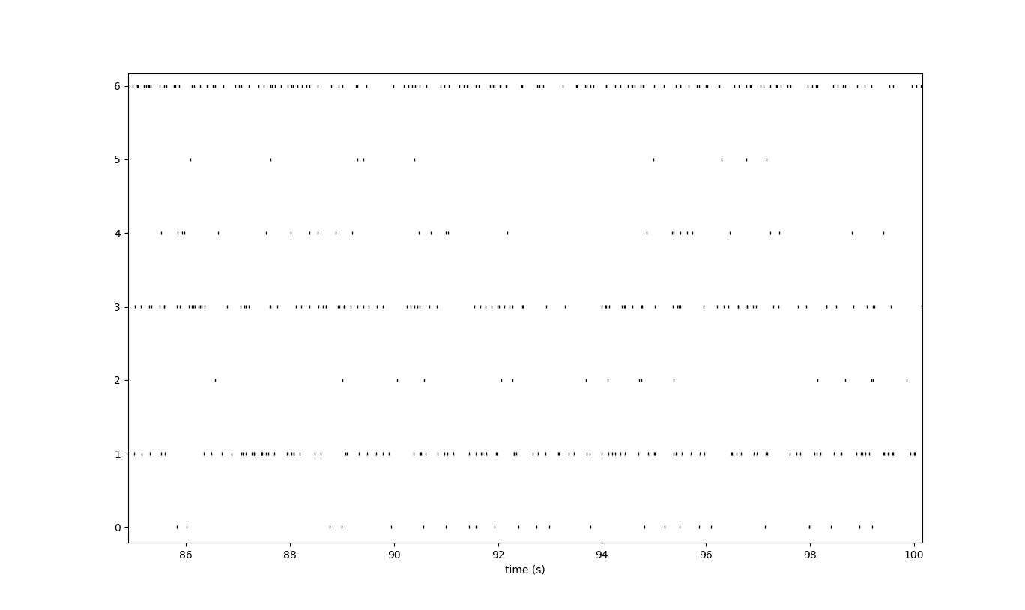
Some Plots and Results
Raw data from 4 channels of a recording data set
Raster plots
Raster Plots- time a spike was present in the recorded voltage trace with a line.

Slide 5
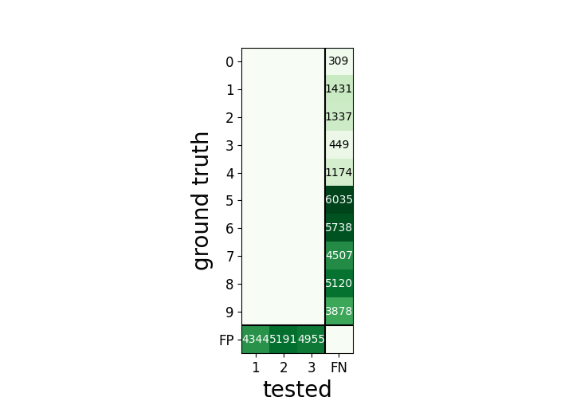
Validation of Data
The sorting output is compared to the ground truth data using statistical tools like agreement matrix.
True Positives –spike found both in ground truth data and sorted output.
Accuracy is one such measure plotted in this matrix.

Slide 6
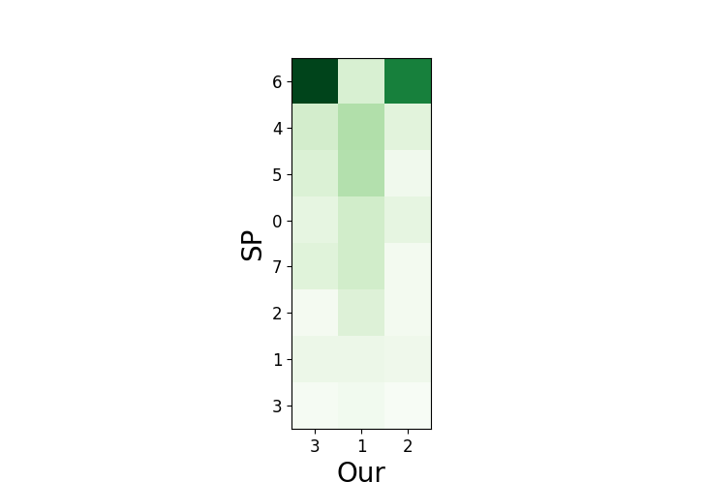
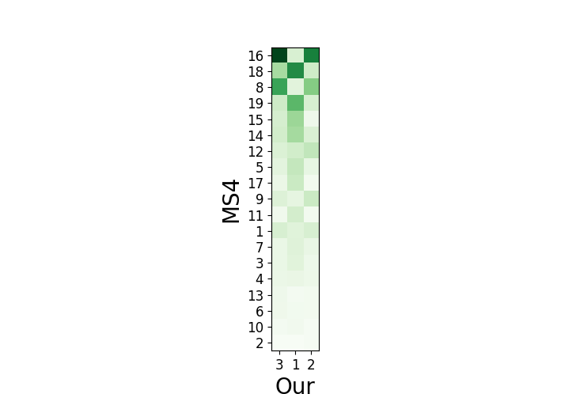
A pair-wise comparison between different sorters and the uNIT algorithm.

Slide 7
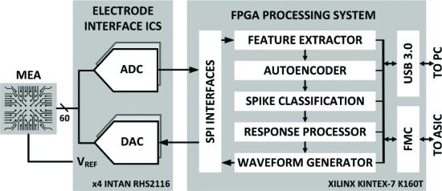




Going forward-next steps (June 5-July 5)
μNIT –Exponential Decaying Memory Tree algorithm.
Benchmarking these algorithms using Spike Forest and Spike Interface .
Leaderboard like comparison of these algorithms.
NETRODE: Neuro-inspired Event-driven Transmitter and Responsive Distributed Electro-stimulator

Slide 8
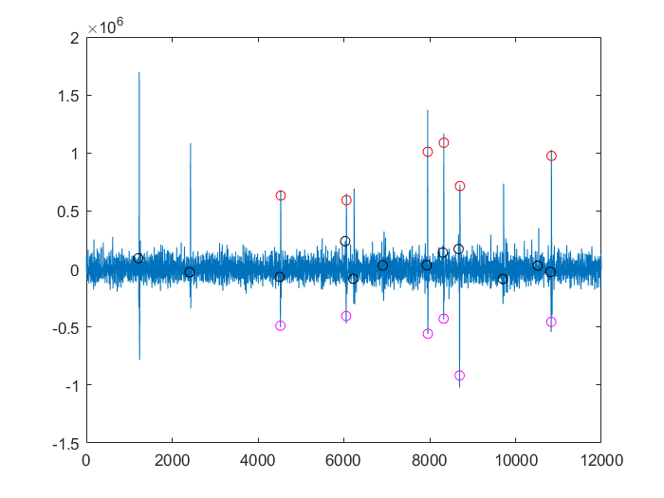
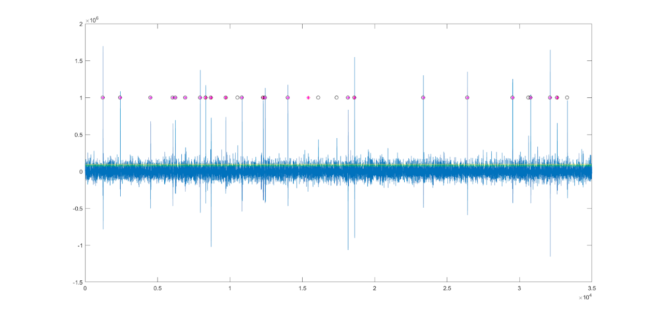
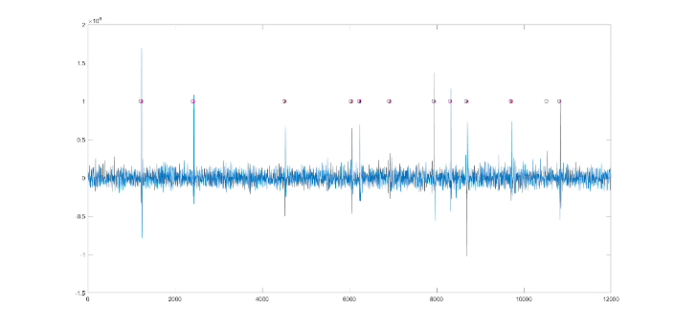
Experimenting with the MATLAB Algorithm
The data-set to be used for final benchmarking is SYNTH_MONOTRODE-single channel format, extracellular.
The plots on the right illustrate the spike events detected by the algorithm along with the spike events found in the ground truth.

Slide 9
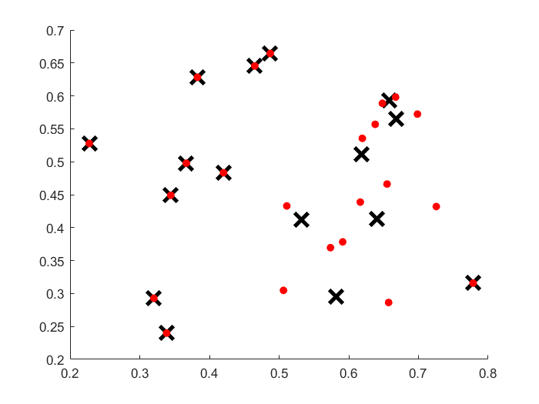
Going forward-Clustering and Feature Extraction.
Making changes to existing MATLAB code, to improve the clustering and feature extraction methods, based on comparisons with ground truth.
Example-increasing the number of hidden layers in Autoencoder.

